Slide 1

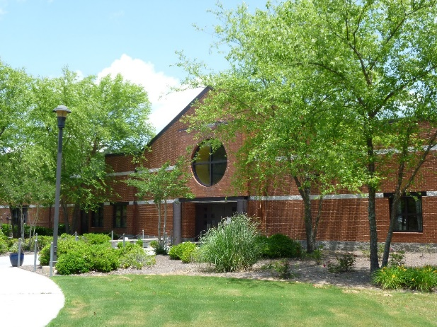
Welcome to
Lost Mountain Middle School
Students and Parents!
We are so happy to have you as
a Lost Mountain Eagle for 2020-2021!

Slide 2
Meet our
Administration and Teachers
Dr. Lenora Nyeste, Principal
Mrs. Shannon Kiger, Assistant Principal
Mrs. Allison Paulk, Assistant Principal
Dr. Zac Wilson, Administrator
Mrs. Christy Gilley, Support Services
Notes:
Candace speaks

Slide 3

Meet our Counselors
Mrs. Tracy Fields & Mrs. Valerie Wombles
Social Emotional Support
Classroom Guidance/ Academic Support
Grade Level Support
Career Awareness
Summer Preparation for August and Registration
Notes:
Allison intro’s both and Tracy speaks

Slide 4
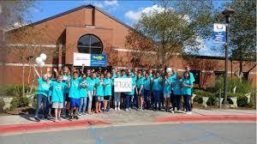
What do we believe about Middle School?
Time to build academic skills for success
Grow and develop interpersonal skills
  Self-advocacy
  Strength of character
  Responsibility
  Organization
Recognize that each grade in middle school has different demands
Have a well rounded experience
Notes:
Candace

Slide 5
What does the middle school day look like?
Morning Arrival
  Morning Drop off begins at 8:15
  Students enter at the theater
  Study Hall 8:15 to 8:50
  Students need a pass in advance from a teacher to visit other destinations
  Buses begin to arrive at 8:50
  Homeroom Begins at 9:10
7 Period Day- Traditional Schedule with Quarterly Grades
Dismissal at 4:15
  Please drop off bus passes in the front office before homeroom
Notes:
Candace Speaks

Slide 6

What if…
Tardy to school – visit main office after 9:10 to sign in
Absent - Bring a note within 3 days of returning to school to front office
Transportation changes – must contact main office before 3:00 PM, in order to be car rider written information required
Checking out of school early- student should bring note to front office before 9:10 to receive early dismissal pass; if no note, parents may not sign out students after 3:45 PM
Want to eat lunch with child – sign-in
Medical needs- See Clinic tab on school website
Volunteer Opportunities- PTSA, Foundation, Media Center, Assist with Clubs, Music Programs

Slide 7

Forgotten Items
Each student is limited to 3 item drop-offs per year to front office (school assignment, lunch, instrument, etc…)
  *Lunch charges are permitted up to $5.20 (Any charges over $5.20 will result in a student offered an alternate meal of a cheese sandwich and milk. No charges for a la carte items.
*Students must use the office phone, not a cell phone, to
call during the school day, if they need to reach out to their
parent. Please do not text your students during school day.

Slide 8
How are students placed in classes?
When will we receive a schedule?
5 Academic Classes
  On-Level Courses or Advanced Content
2 Connections Classes
  Music classes are chosen after students have been introduced to the programs
  All other classes are determined through a random rotation
AC Placement
Serve the top 20-25% in each subject
Mailed at the end of May
Advanced Content Placement Chart - Located on the LMMS web site
Final Schedule Distribution
First Day of School in Homeroom
Notes:
Candace speaks

Slide 9




What do you need to know about connections classes?
Randomly Assigned:
Physical Education
Music Technology
Art
Business
FACS
Health
Music Choices:
  Band
  Chorus
  Orchestra
Notes:
Candace Introduces Suzanne (speaks) and Jenny (Speaks)

Slide 10
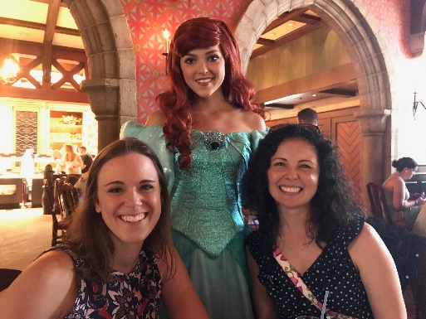
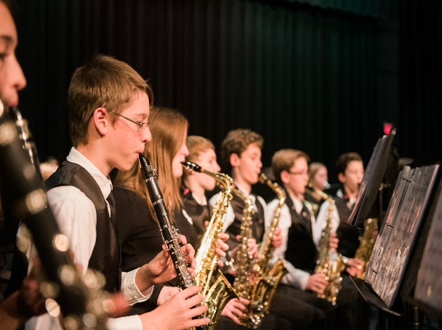
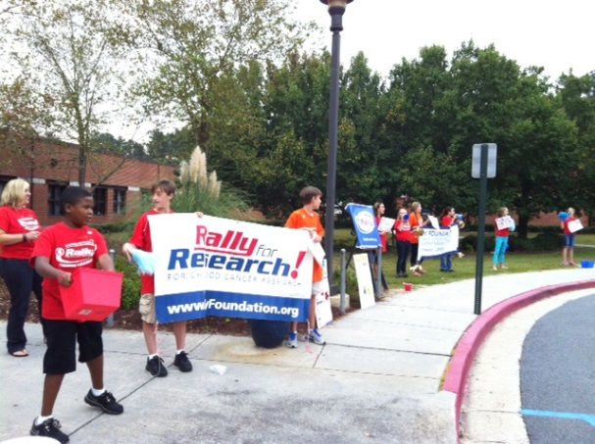
LMMS Band
WEBSITE: lmmsband.com
Email: lostmountainband@gmail.com
Band Directors:
Instruments in the Band:
Woodwind Brass Percussion
Flute - Clarinet - Alto Saxophone Trumpet - Trombone Bells - Snare Drum
Oboe* - Bassoon* French Horn* – Tuba* Hand Instruments*
Euphonium* Large Drums*
* School provided instruments
Suzanne Tingle & Caitlin Watts
Make music with your friends – everyday!
All levels welcome – no experience necessary!
No before or after school rehearsals.
Award-winning programs: LMMS, Harrison HS, Hillgrove HS

Slide 11

LMMS Band
WEBSITE: lmmsband.com

Slide 12

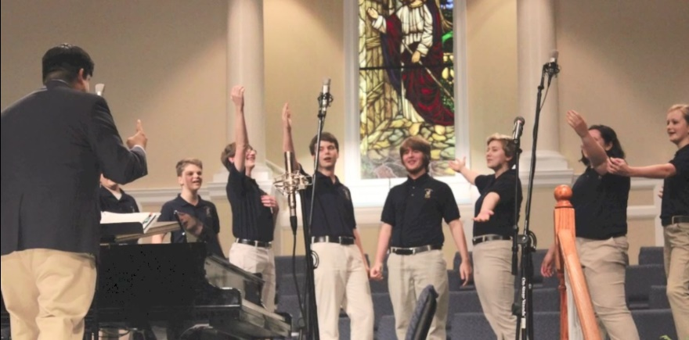
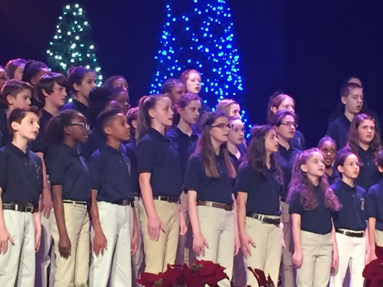


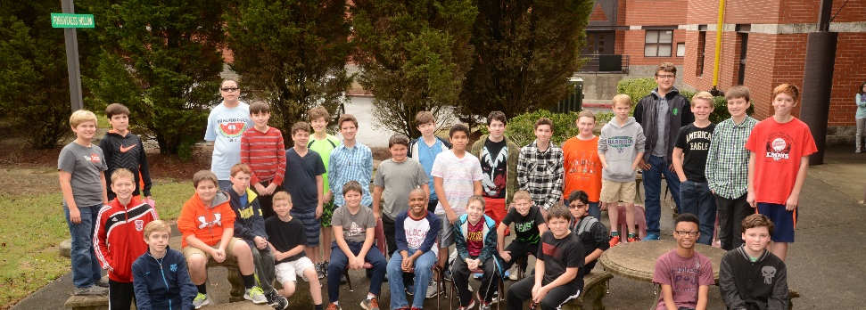
6th, 7th, and 8th Grade Chorus Classes
Boys Chorus & Girls Chorus meet before school and get extra rewards.
Long traditions of excellence. One of the best choral programs in the state.
No experience necessary. We teach all levels!
Join with friends & have 3 years of fun together.
If you can talk, you can sing!
Notes:
Tracy speaks

Slide 13


Notes:
Tracy speaks

Slide 14
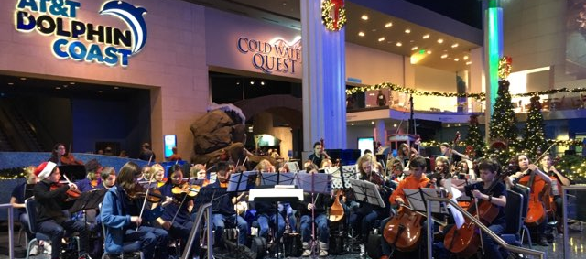
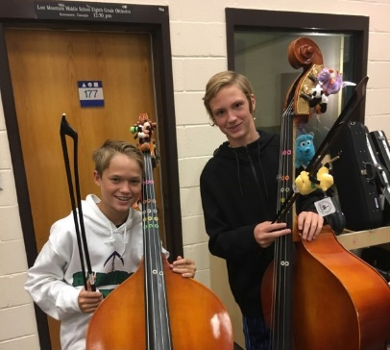

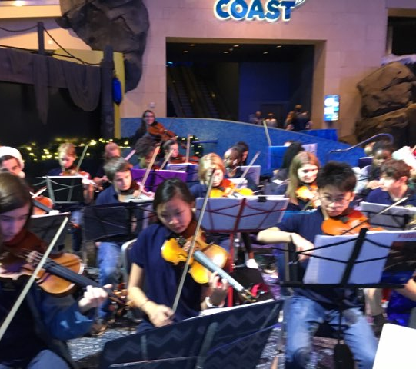
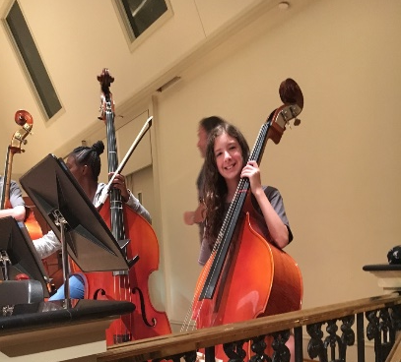
LMMS Orchestra website: lmmsorchestra.com email: linda.stephens@cobbk12.org
Directors: Linda Stephens and Catey Bitinas
In the Orchestra you can:
Learn to play the Violin, Viola, Cello, or Bass.
Learn to play fun popular music!!
Learn how to fiddle!!
Play fun concerts at the Georgia Aquarium!
Play at Strings Jamboree with other middle school orchestras.
Decorate your instruments!!
Go to Disney World in the 8th grade.

Slide 15
LMMS Orchestra
website: lmmsorchestra.com

Slide 16
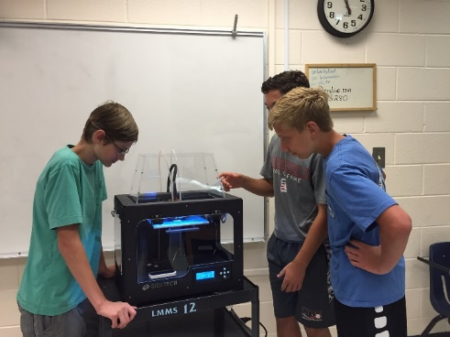

What does the Foundation do at LMMS?
Foundation has recently funded a 3D Printer, iPad Cart, Laptop Cart Teacher Grants
Foundation Priority:
Technology in the classroom for students as we strive for STEM certification
Visit our web site at www.lmmsfoundation.com
and see how you can be a part of
“Empowering Students to Soar”.

Slide 17
What is different in middle school?
BYOD
Dress Code
Cell Phones
Lockers
Homework Grades
Dressing Out
Discipline and Consequences
Eagle Card
Notes:
Candace speaks

Slide 18
Dress Code
To promote a safe environment that is aligned with our school vision of expanding the pursuit of excellence.
As a general rule of thumb, avoid the 3 “B’s”: Bellies, Breasts, and Bottoms. Exposure of any of the “B’s” will be addressed. Students must be fully clothed at all times.
MINIMUM STANDARD OF DRESS
All students shall maintain the following minimum standard of dress:
1. Appropriate shoes shall be worn.
2. Midriffs shall be covered.
3. Appropriate under-garments shall be worn and may not be visible.
4. Strapless garments shall be worn with a jacket.
5. Tank-tops (anything less than 2 inches width at shoulder) shall be worn with a jacket.
6. Appropriate shorts, as determined by the school administration, may be worn.
7. No caps, hats, bandanas nor hoods covering the head are to be worn in the school buildings during the school day, unless there is a special activity in which they are deemed appropriate by the school administration.
8. Clothing or ornamentation that does any of the following is prohibited: a. Displays or advertises substances illegal for minors.
b. Displays suggestive phrases, designs, markings, or profanities.
c. Advocates, promotes, or suggests illegal activity.
*The principal or designee shall be the final judge as to the appropriateness of the apparel, and whether the apparel is disruptive, unsafe, or in violation of the dress code. If in doubt, do not wear the outfit.

Slide 19
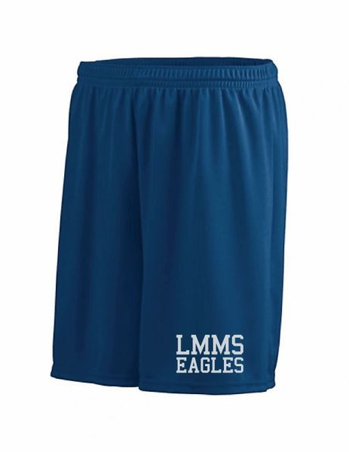
Physical Education
Dress Requirements
Physical Education Dress Requirements:
*All students MUST change clothes each day for physical education classes.
*Students are required to wear uniform PE shorts and t-shirt as a PE uniform. (PE shorts will be available for purchase on school website at start of school.)
*Athletic shoes must be worn.
*Deodorant is required
*No aerosol colognes/body sprays or aerosol deodorant to be sprayed at school
*Shirts cannot be longer than bottoms. It must be obvious that you are wearing bottoms.
*The principal or designee shall be the final judge as to the appropriateness of the apparel, and whether the apparel is disruptive, unsafe, or in violation of the dress code. If in doubt, do not wear the outfit.

Slide 20

Electronic Devices
All personal electronic devices (cell phones, tablets, iPods, PSPs, Smart watches, audio earpieces/ air pods, headphone, etc.) must be turned off, including the notification setting, upon arrival at school. Beginning at 8:50, all personal electronic devices must remain in the student’s locker until the end of the school day.
If a teacher allows BYOD for a specific class period, the student will be notified the previous day. Students will be required to immediately put their personal device back in the locker before the end of the class period. Students cannot be on their device until they are at the bus port (not walking to the bus port) or in the car rider line at the end of the day.

Slide 21


Getting ready for the first week...
Meet & Greet ~ Visit Homeroom Class
Supply lists will be posted on the web site
Folder, paper and pen/pencil for first day
Lockers after paperwork is returned
No book bags in classes after lockers are distributed
Textbooks after lockers are distributed
Lunch in 600 commons –
25 minutes (no microwave)
Notes:
Candace

Slide 22
What should you remember as you prepare for middle school?
Caring teachers and staff
New experiences are good.
Middle school is full of firsts.
We are building skills for the future.
Develop a well rounded child.
Organization is key to success.
Create a routine prepare for a new schedule in advance.
Guide your child toward independence; we will help you.
Notes:
Candace speaks

Slide 23
How are unique student needs supported?
Established Programs
Advance Content Courses (AC)
  Serves gifted and high performing students
Special Education Services
  Provides individual student support
Response to Intervention (RTI)
  A problem-solving model to provide assistance to match a student’s need
Counseling Services
  Provide support to meet the students’ academic, social and organizational needs in the middle grades
Notes:
Allison P. speaks

Slide 24
How to have a great middle school experience?
Focus on organization
  Notebooks
  HW folder
Online Gradebook
  Have your child check grades
Establish a routine for your child to compare their student agenda to the teachers’ blogs
Notes:
Tracy speaks

Slide 25
How do I stay connected to what is going on at LMMS?
Check the teacher blogs
Frequent the online-gradebook for updates
Sign up for the LMMS PTSA e-blasts
Follow the LMMS PTSA on Facebook
Check our school website
Listen for our “dial-out messages” and read text messages and email blasts
Come to school events
Email if you have questions
Volunteer
Notes:
Tracy speaks

Slide 26

How can your child get involved?
FULL LIST ON WEBSITE
Join our Extracurricular Clubs and Organizations
Pep Band
Jr. Beta Club
Student Council
Stand Up for Healthy Habits
Book Club
Helping Hands
Morning Broadcast Team
Academic Team
F. C. A.
Music Chamber
Coding Club
STEM Club
Notes:
Allison P. speaks

Slide 27

How can you get involved?
Represent parents on the School Council
Become a member of the LMMS Foundation
Join PTSA
Volunteer in our school
Notes:
Candace speaks

Slide 28
What does the Foundation do at LMMS?
Foundation has recently funded a 3D Printer, iPad Cart, Laptop Cart Teacher Grants
Foundation Priority:
Technology in the classroom for students as we strive for STEM certification
Visit our web site at www.lmmsfoundation.com
and see how you can be a part of
“Empowering Students to Soar”.

Slide 29
What does PTSA do at LMMS?
Funds Agendas for all students
Organizes grade level social events and activities
Helps run book fairs each year
Teacher of the Month recognition
Teacher Appreciation Week
Provides resources for our school
Offers teacher grants
Provides financial support to clubs
Administers Hearing & Vision tests to all 7th graders
Eagle Supporter Program
Why?
Supports our goals and activities.
Takes the place of PTSA fundraisers
We ask each family to make a tax deductible donation to LMMS PTSA in the beginning of the year.
PTSA

Slide 30


We look forward to seeing you soon!
Notes:
Candace speaks

